Slide 1
Hazel Hunkins: Billings Suffragist
Historic Case File 5 Documents

Slide 2
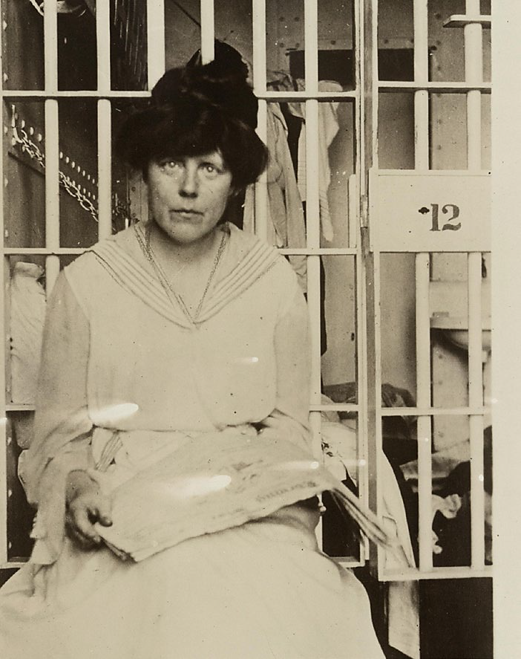
“Miss [Lucy] Burns in Occoquan Workhouse.”
Source: National Woman’s Party Records, Group II, Container II:274, Folder: Individual Photographs Nos. 18-70 “B,” Library of Congress Prints and Photographs Division, Washington, D.C.

Slide 3
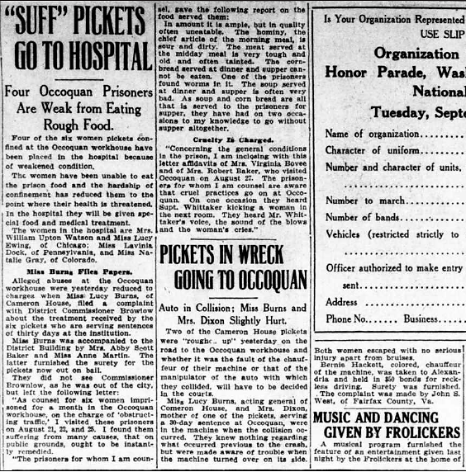
“ ‘Suff’ Pickets Go To Hospital,” Washington [D.C.] Herald, August 31, 1917
The full page is available at http://chroniclingamerica.loc.gov/lccn/sn83045433/1917-08-31/ed-1/seq-7.pdf

Slide 4
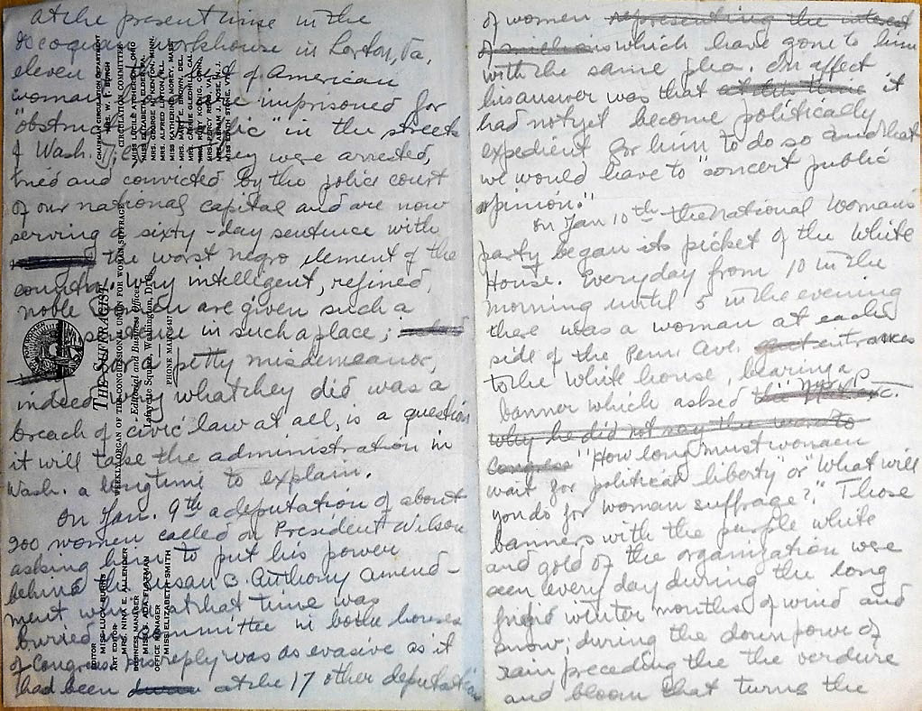
Hazel Hunkins to the Montana Socialist newspaper.
(Pages 1-2/8)
Source: Hazel Hunkins-Hallinan Papers, MC 532, box 61, folder 9, Schlesinger Library, Radcliffe Institute.

Slide 5
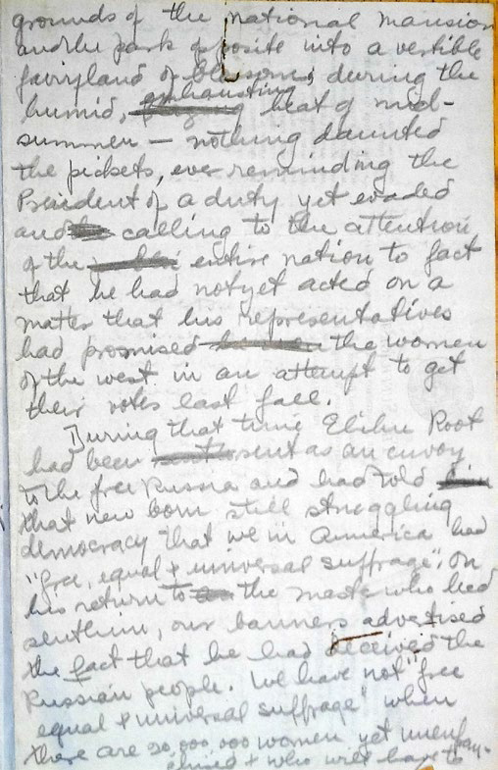
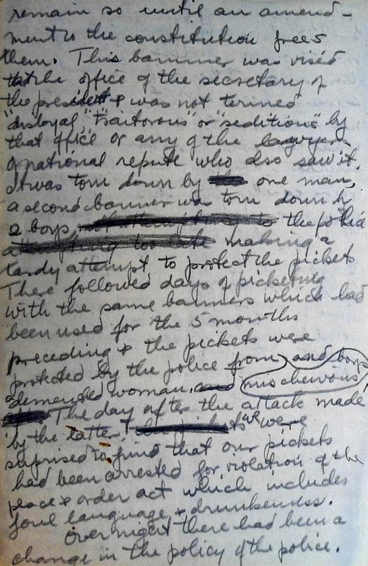
Hazel Hunkins to the Montana Socialist newspaper.
(Pages 3-4/8)
Source: Hazel Hunkins-Hallinan Papers, MC 532, box 61, folder 9, Schlesinger Library, Radcliffe Institute.

Slide 6
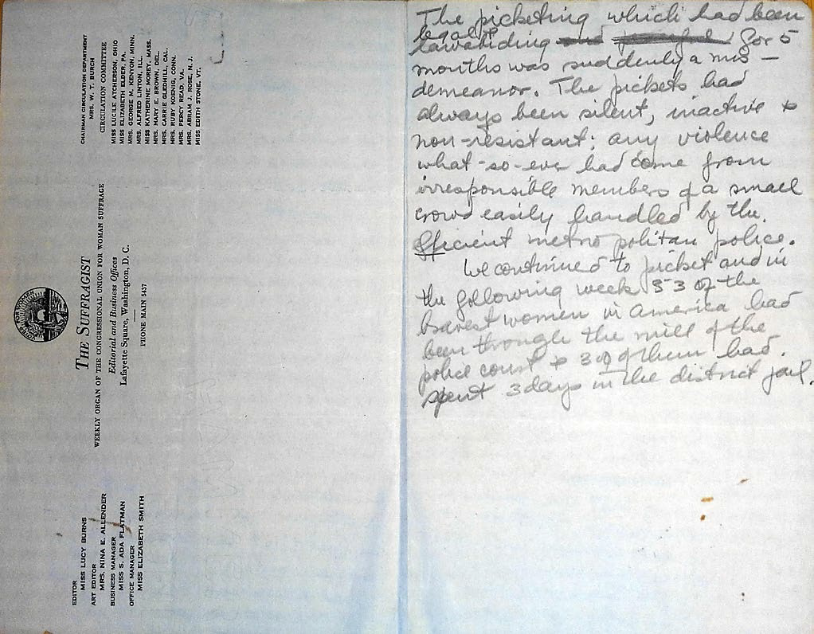
Hazel Hunkins to the Montana Socialist newspaper.
(Pages 5-6/8)
Source: Hazel Hunkins-Hallinan Papers, MC 532, box 61, folder 9, Schlesinger Library, Radcliffe Institute.

Slide 7
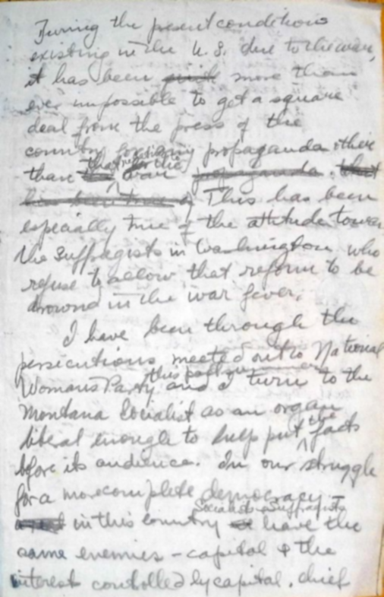
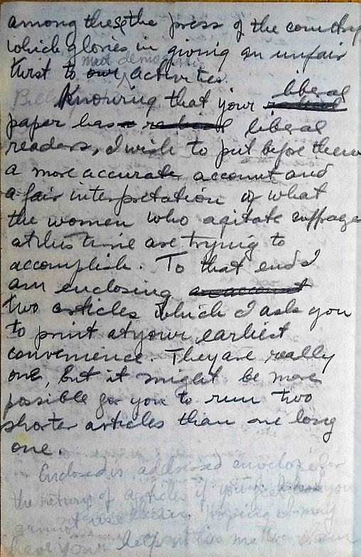
Hazel Hunkins to the Montana Socialist newspaper.
(Pages 7-8/8)
Source: Hazel Hunkins-Hallinan Papers, MC 532, box 61, folder 9, Schlesinger Library, Radcliffe Institute.

Slide 8
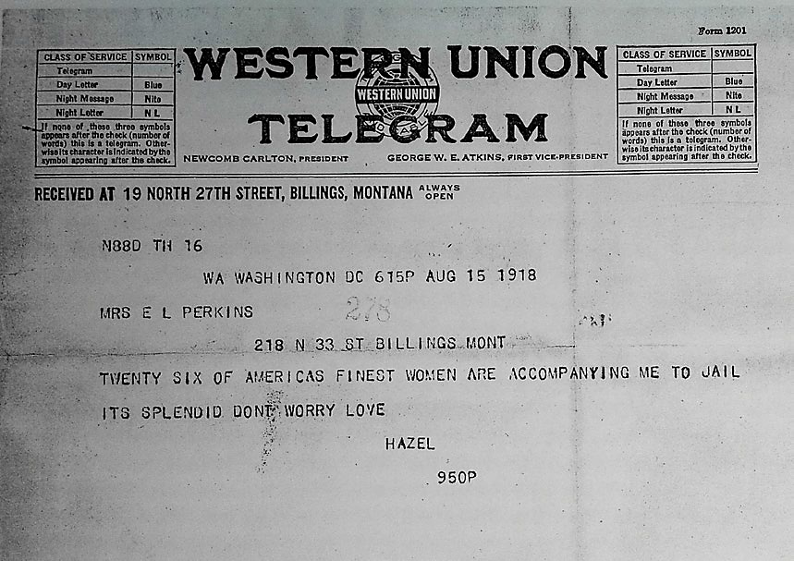
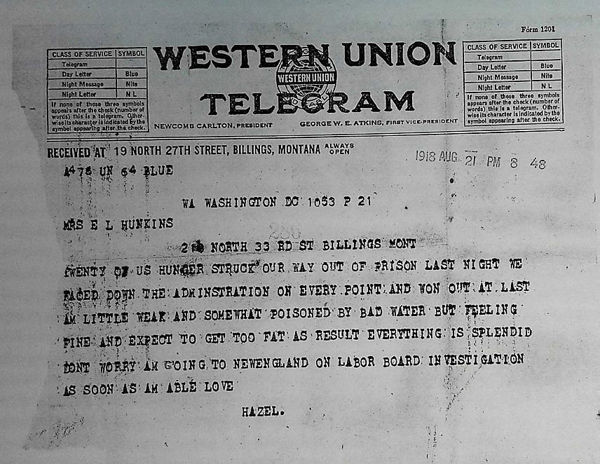
Hazel Hunkins to Mrs. E. L. Perkins, August 15, 1918, and Hunkins to Mrs. E. L. Hunkins, August 21, 1918
Source: Hazel Hunkins-Hallinan Papers, MC 532, box 61, folder 9, Schlesinger Library, Radcliffe Institute

Slide 9
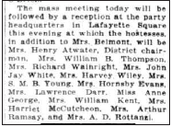
“Twenty-six Suffragists Get Tribute,” Washington [D.C.] Herald, December 15, 1918
The full page is available at http://chroniclingamerica.loc.gov/lccn/sn83045433/1918-12-15/ed-1/seq-4.pdf

Slide 10
For the accompanying lesson plan
and more information, visit: http://mhs.mt.gov/education/women/HazelHunkins
Montana Historical Society
Outreach and Interpretation Program
P.O. Box 201201, Helena, MT 59620
406-444-4740

